Slide 1
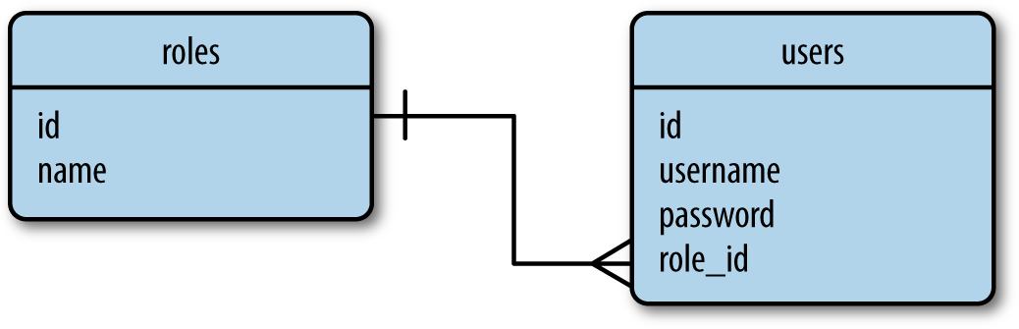
Chapter 7
Databases
SQL Databases
Figure 5-1 shows a diagram of a simple database with two tables that store users and user roles. The line that connects the two tables represents a relationship between the tables.

Slide 2
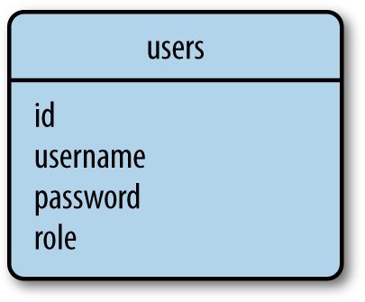
NoSQL Databases
Databases that do not follow the relational model described in the previous section are collectively referred to as NoSQL databases. One common organization for NoSQL databases uses collections instead of tables and documents instead of records. NoSQL databases are designed in a way that makes joins difficult, so most of them do not support this operation at all.

Slide 3
SQL or NoSQL?
- SQL databases excel at storing structured data in an efficient and compact form. These databases go to great lengths to preserve consistency, even in the face of power failures or hardware malfunctions. The paradigm that allows relational databases to reach this high level of reliability is called ACID, which stands for Atomicity, Consistency, Isolation, and Durability.
- NoSQL databases relax some of the ACID requirements and as a result can sometimes get a performance edge.
For small to medium-sized applications, both SQL and NoSQL databases are perfectly capable and have practically equivalent performance.
Python Database Frameworks
Python has packages for most database engines, both open source and commercial. Flask puts no restrictions on what database packages can be used, so you can work with MySQL, Postgres, SQLite, Redis, MongoDB, CouchDB, or DynamoDB if any of these is your favorite.

Slide 4
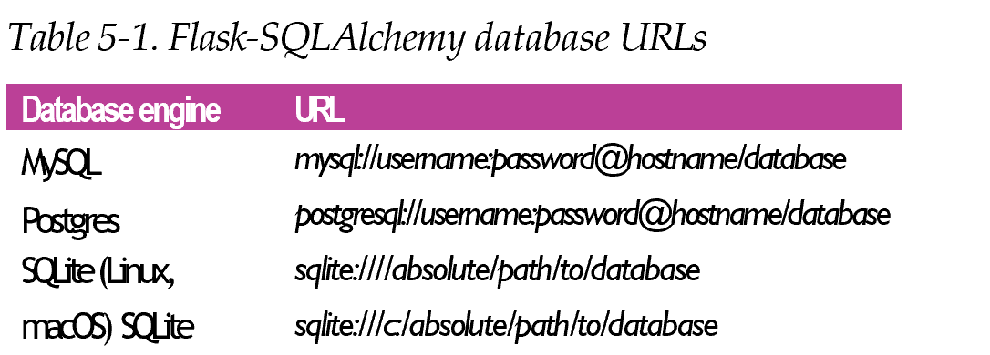
Database Management with Flask-SQLAlchemy

Slide 5
Database Management with Flask-SQLAlchemy
Like most other extensions, Flask-SQLAlchemy is installed with pip:
(venv) $ pip install flask-sqlalchemy
Example 5-1. hello.py: database configuration
import os
from flask_sqlalchemy import SQLAlchemy
basedir = os.path.abspath(os.path.dirname(__file__))
app = Flask(__name__) app.config['SQLALCHEMY_DATABASE_URI'] =\
'sqlite:///' + os.path.join(basedir, 'data.sqlite') app.config['SQLALCHEMY_TRACK_MODIFICATIONS'] = False
db = SQLAlchemy(app)
The db object instantiated from the class SQLAlchemy represents the database and provides access to all the functionality of Flask-SQLAlchemy.

Slide 6
Model Definition
The database instance from Flask-SQLAlchemy provides a base class for models as well as a set of helper classes and functions that are used to define their structure. The roles and users tables from Figure 5-1 can be defined as the models Role and User as shown in Example 5-2.
Example 5-2. hello.py: Role and User model definition
class Role(db.Model):
tablename = 'roles'
id = db.Column(db.Integer, primary_key=True)
name = db.Column(db.String(64), unique=True)
def __repr__(self):
return '<Role %r>' % self.name
class User(db.Model):
tablename = 'users'
id = db.Column(db.Integer, primary_key=True)
username = db.Column(db.String(64), unique=True, index=True)
def __repr__(self):
return '<User %r>' % self.username

Slide 7
Table 5-2. Most common SQLAlchemy column types
Type name Python type Description
Integer SmallInteger BigInteger Float Numeric String
Text Unicode UnicodeText Boolean Date
Time DateTime Interval Enum PickleType LargeBinary
Regular integer, typically 32 bits Short-range integer, typically 16 bits
Unlimited precision integer
Floating-point number
Fixed-point number
Variable-length string
Variable-length string, optimized for large or unbounded length
Variable-length Unicode string
Variable-length Unicode string, optimized for large or unbounded length
Boolean value
Date value
Time value
Date and time value
Time interval
List of string values Automatic
Pickle serialization Binary blob
int
Int
int or long
float
decimal.Decimal
str
str
unicode unicode bool
datetime.date datetime.time datetime.datetime datetime.timedelta str
Any Python object
str

Slide 8
The remaining arguments to db.Column specify configuration options for each attribute. Table 5-3 lists some of the options available.
Table 5-3. Most common SQLAlchemy column options
Option name Description
primary_key If set to True, the column is the table’s primary key.
unique index
If set to True, do not allow duplicate values for this column.
If set to True, create an index for this column, so that queries are more efficient.
Nullable If set to True, allow empty values for this column. If set to False, the column will not allow null values.
default Define a default value for the column.

Slide 9
Relationships
Relational databases establish connections between rows in different tables through the use of relationships. The relational diagram in Figure 5-1 expresses a simple rela‐ tionship between users and their roles. This is a one-to-many relationship from roles to users, because one role can belong to many users, but each user can have only one role.
Example 5-3 shows how the one-to-many relationship in Figure 5-1 is represented in the model classes.
Example 5-3. hello.py: relationships in the database models
class Role(db.Model):
# ...
users = db.relationship('User', backref='role')
class User(db.Model):
# ...
role_id = db.Column(db.Integer, db.ForeignKey('roles.id'))

Slide 10
Table 5-4. Common SQLAlchemy relationship options
Option name Description
backref primaryjoin
Add a back reference in the other model in the relationship.
Specify the join condition between the two models explicitly. This is necessary only for ambiguous relationships.
Specify how the related items are to be loaded. Possible values are select (items are loaded on demand the first time they are accessed), immediate (items are loaded when the source object is loaded), joined (items are loaded immediately, but as a join), subquery (items are loaded immediately, but as a subquery), noload (items are never loaded), and dynamic (instead of loading the items, the query that can load them is given).
If set to False, use a scalar instead of a list.
Specify the ordering used for the items in the relationship.
Specify the name of the association table to use in many-to-many relationships.
Specify the secondary join condition for many-to-many relationships when SQLAlchemy cannot determine it on its own.
lazy
uselist order_by secondary secondaryjoin

Slide 11
Database Operations
The following sections will walk you through the most common data‐ base operations in a shell started with the flask shell command. Before you use this command, make sure the FLASK_APP environment variable is set to hello.py, as shown in Chapter 2.
Creating the Tables
The very first thing to do is to instruct Flask-SQLAlchemy to create a database based on the model classes. The db.create_all() function locates all the subclasses of db.Model and creates corresponding tables in the database for them:
(venv) $ flask shell
>>> from hello import db
>>> db.create_all()

Slide 12
The brute-force solution to update existing database tables to a different schema is to remove the old tables first:
>>> db.drop_all()
>>> db.create_all()
Inserting Rows
The following example creates a few roles and users:
>>> from hello import Role, User
>>> admin_role = Role(name='Admin')
>>> mod_role = Role(name='Moderator')
>>> user_role = Role(name='User')
>>> user_john = User(username='john', role=admin_role)
>>> user_susan = User(username='susan', role=user_role)
>>> user_david = User(username='david', role=user_role)

Slide 13
The objects exist only on the Python side so far; they have not been written to the database yet. Because of that, their id values have not yet been assigned:
>>> print(admin_role.id)
None
>>> print(mod_role.id)
None
>>> print(user_role.id)
None
Changes to the database are managed through a database session, which Flask- SQLAlchemy provides as db.session. To prepare objects to be written to the data‐ base, they must be added to the session:
>>> db.session.add(admin_role)
>>> db.session.add(mod_role)
>>> db.session.add(user_role)
>>> db.session.add(user_john)
>>> db.session.add(user_susan)
>>> db.session.add(user_david)
Database sessions are also called transactions.

Slide 14
Or, more concisely:
>>> db.session.add_all([admin_role, mod_role, user_role,
... user_john, user_susan, user_david])
To write the objects to the database, the session needs to be committed by calling its
commit() method:
>>> db.session.commit()
Check the id attributes again after having the data committed to see that they are now set:
>>> print(admin_role.id)
1
>>> print(mod_role.id)
2
>>> print(user_role.id)
3
The db.session database session is not related to the Flask session object discussed in Chapter 4.

Slide 15
Modifying Rows
The add() method of the database session can also be used to update models. Con‐ tinuing in the same shell session, the following example renames the "Admin" role to "Administrator":
>>> admin_role.name = 'Administrator'
>>> db.session.add(admin_role)
>>> db.session.commit()
Deleting Rows
The database session also has a delete() method. The following example deletes the
"Moderator" role from the database:
>>> db.session.delete(mod_role)
>>> db.session.commit()
Note that deletions, like insertions and updates, are executed only when the database session is committed.

Slide 16
Querying Rows
Flask-SQLAlchemy makes a query object available in each model class. The most basic query for a model is triggered with the all() method, which returns the entire contents of the corresponding table:
>>> Role.query.all()
[<Role 'Administrator'>, <Role 'User'>]
>>> User.query.all()
[<User 'john'>, <User 'susan'>, <User 'david'>]
A query object can be configured to issue more specific database searches through the use of filters. The following example finds all the users that were assigned the "User" role:
>>> User.query.filter_by(role=user_role).all()
[<User 'susan'>, <User 'david'>]

Slide 17
It is also possible to inspect the native SQL query that SQLAlchemy generates for a given query by converting the query object to a string:
>>> str(User.query.filter_by(role=user_role))
'SELECT users.id AS users_id, users.username AS users_username,
users.role_id AS users_role_id \nFROM users \nWHERE :param_1 = users.role_id'
The following example issues a query that loads the user role with name "User":
>>> user_role = Role.query.filter_by(name='User').first()
Table 5-5 shows some of the most common filters available to queries. The complete list is in the SQLAlchemy documentation.
Table 5-5. Common SQLAlchemy query filters
Option Description
filter() filter_by() limit() offset() order_by() group_by()
Returns a new query that adds an additional filter to the original query
Returns a new query that adds an additional equality filter to the original query
Returns a new query that limits the number of results of the original query to the given number
Returns a new query that applies an offset into the list of results of the original query
Returns a new query that sorts the results of the original query according to the given criteria
Returns a new query that groups the results of the original query according to the given criteria

Slide 18
Table 5-6. Most common SQLAlchemy query executors
Option Description
all() first()
first_or_404()
Returns all the results of a query as a list
Returns the first result of a query, or None if there are no results
Returns the first result of a query, or aborts the request and sends a 404 error as the response if there are no results
Returns the row that matches the given primary key, or None if no matching row is found
Returns the row that matches the given primary key or, if the key is not found, aborts the request and sends a 404 error as the response
Returns the result count of the query
Returns a Pagination object that contains the specified range of results
get() get_or_404()
count() paginate()
Relationships work similarly to queries. The following example queries the one-to- many relationship between roles and users from both ends:
>>> users = user_role.users
>>> users
[<User 'susan'>, <User 'david'>]
>>> users[0].role
<Role 'User'>

Slide 19
Database Use in View Functions
Example 5-4. hello.py: dynamic database relationships
class Role(db.Model):
# ...
users = db.relationship('User', backref='role', lazy='dynamic')
# ...
With the relationship configured in this way, user_role.users returns a query that hasn’t executed yet, so filters can be added to it:
>>> user_role.users.order_by(User.username).all()
[<User 'david'>, <User 'susan'>]
>>> user_role.users.count()
2

Slide 20
Example 5-5. hello.py: database use in view functions
@app.route('/', methods=['GET', 'POST'])
def index():
form = NameForm()
if form.validate_on_submit():
user = User.query.filter_by(username=form.name.data).first()
if user is None:
user = User(username=form.name.data) db.session.add(user) db.session.commit()
session['known'] = False
else:
session['known'] = True session['name'] = form.name.data form.name.data = ''
return redirect(url_for('index'))
return render_template('index.html', form=form, name=session.get('name'), known=session.get('known', False))

Slide 21
Integration with the Python Shell
Example 5-7. hello.py: adding a shell context
@app.shell_context_processor
def make_shell_context():
return dict(db=db, User=User, Role=Role)
The shell context processor function returns a dictionary that includes the database instance and the models. The flask shell command will import these items auto‐ matically into the shell, in addition to app, which is imported by default:
$ flask shell
>>> app
<Flask 'hello'>
>>> db
<SQLAlchemy engine='sqlite:////home/flask/flasky/data.sqlite'>
>>> User
<class 'hello.User'>

Slide 22
Creating a Migration Repository
To begin, Flask-Migrate must be installed in the virtual environment:
(venv) $ pip install flask-migrate
Example 5-8. hello.py: Flask-Migrate initialization
from flask_migrate import Migrate
# ...
migrate = Migrate(app, db)
To expose the database migration commands, Flask-Migrate adds a flask db com‐ mand with several subcommands. When you work on a new project, you can add support for database migrations with the init subcommand:
(venv) $ flask db init
Creating directory /home/flask/flasky/migrations...done
Creating directory /home/flask/flasky/migrations/versions...done Generating /home/flask/flasky/migrations/alembic.ini...done Generating /home/flask/flasky/migrations/env.py...done Generating /home/flask/flasky/migrations/env.pyc...done Generating /home/flask/flasky/migrations/README...done Generating /home/flask/flasky/migrations/script.py.mako...done Please edit configuration/connection/logging settings in '/home/flask/flasky/migrations/alembic.ini' before proceeding.

Slide 23
Creating a Migration Script
To make changes to your database schema with Flask-Migrate, the following proce‐ dure needs to be followed:
Make the necessary changes to the model classes.
Create an automatic migration script with the flask db migrate command.
Review the generated script and adjust it so that it accurately represents the changes that were made to the models.
Add the migration script to source control.
Apply the migration to the database with the flask db upgrade command.
The flask db migrate subcommand creates an automatic migration script:
(venv) $ flask db migrate -m "initial migration"
INFO INFO INFO INFO INFO
[alembic.migration] Context impl SQLiteImpl.
[alembic.migration] Will assume non-transactional DDL.
[alembic.autogenerate] Detected added table 'roles'
[alembic.autogenerate] Detected added table 'users'
[alembic.autogenerate.compare] Detected added index
'ix_users_username' on '['username']'
Generating /home/flask/flasky/migrations/versions/1bc 594146bb5_initial_migration.py...done

Slide 24
Upgrading the Database
Once a migration script has been reviewed and accepted, it can be applied to the data‐ base using the flask db upgrade command:
(venv) $ flask db upgrade
INFO INFO INFO
[alembic.migration] Context impl SQLiteImpl.
[alembic.migration] Will assume non-transactional DDL.
[alembic.migration] Running upgrade None -> 1bc594146bb5, initial migration
Adding More Migrations
The procedure to introduce a change in the database is similar to what was done to introduce the first migration:
Make the necessary changes in the database models.
Generate a migration with the flask db migrate command.
Review the generated migration script and correct it if it has any inaccuracies.
Apply the changes to the database with the flask db upgrade command.
While working on a specific feature, you may find that you need to make several changes to your database models before you get them the way you want them.

Slide 25
If your last migration has not been committed to source control yet, you can opt to expand it to incorporate new changes as you make them, and this will save you from having lots of very small migration scripts that are meaningless on their own. The procedure to expand the last migration script is as follows:
Remove the last migration from the database with the flask db downgrade com‐ mand (note that this may cause some data to be lost).
Delete the last migration script, which is now orphaned.
Generate a new database migration with the flask db migrate command, which will now include the changes in the migration script you just removed, plus any other changes you’ve made to the models.
Review and apply the migration script as described previously.

Slide 26
Email Support with Flask-Mail
Although the smtplib package from the Python standard library can be used to send email inside a Flask application, the Flask-Mail extension wraps smtplib and integra‐ tes it nicely with Flask. Flask-Mail is installed with pip:
(venv) $ pip install flask-mail
The extension connects to a Simple Mail Transfer Protocol (SMTP) server and passes emails to it for delivery. If no configuration is given, Flask-Mail connects to localhost at port 25 and sends email without authentication. Table 6-1 shows the list of configu‐ ration keys that can be used to configure the SMTP server.
Table 6-1. Flask-Mail SMTP server configuration keys
Key Default Description
MAIL_SERVER MAIL_PORT MAIL_USE_TLS MAIL_USE_SSL MAIL_USERNAME MAIL_PASSWORD
localhost Hostname or IP address of the email server
25 Port of the email server
False False None
None
Enable Transport Layer Security (TLS) security
Enable Secure Sockets Layer (SSL) security
Mail account username
Mail account password

Slide 27
Example 6-1. hello.py: Flask-Mail configuration for Gmail
import os
# ...
app.config['MAIL_SERVER'] = 'smtp.googlemail.com' app.config['MAIL_PORT'] = 587
app.config['MAIL_USE_TLS'] = True
app.config['MAIL_USERNAME'] = os.environ.get('MAIL_USERNAME') app.config['MAIL_PASSWORD'] = os.environ.get('MAIL_PASSWORD')
Example 6-2. hello.py: Flask-Mail initialization
from flask_mail import Mail
mail = Mail(app)
The two environment variables that hold the email server username and password need to be defined in the environment. If you are on Linux or macOS, you can set these variables as follows:
(venv) $ export MAIL_USERNAME=<Gmail username>
(venv) $ export MAIL_PASSWORD=<Gmail password>
For Microsoft Windows users, the environment variables are set as follows:
(venv) $ set MAIL_USERNAME=<Gmail username>
(venv) $ set MAIL_PASSWORD=<Gmail password>

Slide 28
Sending Email from the Python Shell
To test the configuration, you can start a shell session and send a test email
(venv) $ flask shell
>>> from flask_mail import Message
>>> from hello import mail
>>> msg = Message('test email', sender='you@example.com',
... recipients=['you@example.com'])
>>> msg.body = 'This is the plain text body'
>>> msg.html = 'This is the <b>HTML</b> body'
>>> with app.app_context():
... mail.send(msg)
...

Slide 29
Integrating Emails with the Application
Example 6-3. hello.py: email support
from flask_mail import Message
app.config['FLASKY_MAIL_SUBJECT_PREFIX'] = '[Flasky]' app.config['FLASKY_MAIL_SENDER'] = 'Flasky Admin <flasky@example.com>'
def send_email(to, subject, template, **kwargs):
msg = Message(app.config['FLASKY_MAIL_SUBJECT_PREFIX'] + subject, sender=app.config['FLASKY_MAIL_SENDER'], recipients=[to])
msg.body = render_template(template + '.txt', **kwargs) msg.html = render_template(template + '.html', **kwargs) mail.send(msg)

Slide 30
Example 6-4. hello.py: email example
# ...
app.config['FLASKY_ADMIN'] = os.environ.get('FLASKY_ADMIN')
# ...
@app.route('/', methods=['GET', 'POST'])
def index():
form = NameForm()
if form.validate_on_submit():
user = User.query.filter_by(username=form.name.data).first()
if user is None:
user = User(username=form.name.data) db.session.add(user) session['known'] = False
if app.config['FLASKY_ADMIN']: send_email(app.config['FLASKY_ADMIN'], 'New User',
'mail/new_user', user=user)
else:
session['known'] = True session['name'] = form.name.data form.name.data = ''
return redirect(url_for('index'))
return render_template('index.html', form=form, name=session.get('name'),
known=session.get('known', False))

Slide 31
For Linux and macOS users, the command to set this variable is:
(venv) $ export FLASKY_ADMIN=<your-email-address>
For Microsoft Windows users, this is the equivalent command:
(venv) $ set FLASKY_ADMIN=<your-email-address>
With these environment variables set, you can test the application and receive an email every time you enter a new name in the form.
Sending Asynchronous Email
Example 6-5. hello.py: asynchronous email support
from threading import Thread
def send_async_email(app, msg): with app.app_context(): mail.send(msg)
def send_email(to, subject, template, **kwargs):
msg = Message(app.config['FLASKY_MAIL_SUBJECT_PREFIX'] + subject, sender=app.config['FLASKY_MAIL_SENDER'], recipients=[to])
msg.body = render_template(template + '.txt', **kwargs) msg.html = render_template(template + '.html', **kwargs) thr = Thread(target=send_async_email, args=[app, msg]) thr.start()
return thr

Slide 32
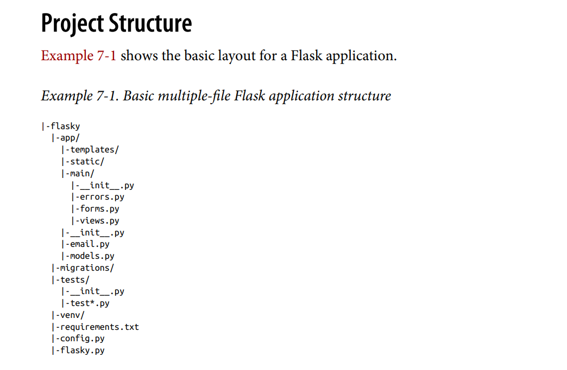
Large Application Structure
Although having small web applications stored in a single script file can be very con‐ venient, this approach does not scale well. As the application grows in complexity, working with a single large source file becomes problematic.
Unlike most other web frameworks, Flask does not impose a specific organization for large projects; the way to structure the application is left entirely to the developer. In this chapter, a possible way to organize a large application in packages and modules is presented. This structure will be used in the remaining examples of the book.

Slide 33
Configuration Options
Example 7-2. config.py: application configuration
import os
basedir = os.path.abspath(os.path.dirname(__file__))
class Config:
SECRET_KEY = os.environ.get('SECRET_KEY') or 'hard to guess string' MAIL_SERVER = os.environ.get('MAIL_SERVER', 'smtp.googlemail.com') MAIL_PORT = int(os.environ.get('MAIL_PORT', '587'))
MAIL_USE_TLS = os.environ.get('MAIL_USE_TLS', 'true').lower() in \ ['true', 'on', '1']
MAIL_USERNAME = os.environ.get('MAIL_USERNAME') MAIL_PASSWORD = os.environ.get('MAIL_PASSWORD') FLASKY_MAIL_SUBJECT_PREFIX = '[Flasky]'
FLASKY_MAIL_SENDER = 'Flasky Admin <flasky@example.com>' FLASKY_ADMIN = os.environ.get('FLASKY_ADMIN') SQLALCHEMY_TRACK_MODIFICATIONS = False

Slide 34
@staticmethod
def init_app(app):
pass
class DevelopmentConfig(Config): DEBUG = True
SQLALCHEMY_DATABASE_URI = os.environ.get('DEV_DATABASE_URL') or \ 'sqlite:///' + os.path.join(basedir, 'data-dev.sqlite')
class TestingConfig(Config): TESTING = True
SQLALCHEMY_DATABASE_URI = os.environ.get('TEST_DATABASE_URL') or \ 'sqlite://'
class ProductionConfig(Config):
SQLALCHEMY_DATABASE_URI = os.environ.get('DATABASE_URL') or \ 'sqlite:///' + os.path.join(basedir, 'data.sqlite')
config = {
'development': DevelopmentConfig, 'testing': TestingConfig, 'production': ProductionConfig,
'default': DevelopmentConfig
}

Slide 35
Example 7-3. app/ init .py: application package constructor
from flask import Flask, render_template from flask_bootstrap import Bootstrap from flask_mail import Mail
from flask_moment import Moment
from flask_sqlalchemy import SQLAlchemy
from config import config
bootstrap = Bootstrap() mail = Mail()
moment = Moment() db = SQLAlchemy()
def create_app(config_name): app = Flask(__name__)
app.config.from_object(config[config_name]) config[config_name].init_app(app)
bootstrap.init_app(app) mail.init_app(app) moment.init_app(app) db.init_app(app)
# attach routes and custom error pages here
return app

Slide 36
Implementing Application Functionality in a Blueprint
Example 7-4. app/main/ init .py: main blueprint creation
from flask import Blueprint
main = Blueprint('main', __name__)
from . import views, errors
Example 7-5. app/ init .py: main blueprint registration
def create_app(config_name):
# ...
from .main import main as main_blueprint app.register_blueprint(main_blueprint)
return app

Slide 37
Example 7-6. app/main/errors.py: error handlers in main blueprint
from flask import render_template
from . import main
@main.app_errorhandler(404)
def page_not_found(e):
return render_template('404.html'), 404
@main.app_errorhandler(500)
def internal_server_error(e):
return render_template('500.html'), 500
A difference when writing error handlers inside a blueprint is that if the errorhandler decorator is used, the handler will be invoked only for errors that orig‐ inate in the routes defined by the blueprint.

Slide 38
Example 7-7. app/main/views.py: application routes in main blueprint
from datetime import datetime
from flask import render_template, session, redirect, url_for
from . import main
from .forms import NameForm
from .. import db
from ..models import User
@main.route('/', methods=['GET', 'POST'])
def index():
form = NameForm()
if form.validate_on_submit():
# ...
return redirect(url_for('.index'))
return render_template('index.html',
form=form, name=session.get('name'), known=session.get('known', False), current_time=datetime.utcnow())

Slide 39
Application Script
The flasky.py module in the top-level directory is where the application instance is defined. This script is shown in Example 7-8.
Example 7-8. flasky.py: main script
import os
from app import create_app, db from app.models import User, Role from flask_migrate import Migrate
app = create_app(os.getenv('FLASK_CONFIG') or 'default') migrate = Migrate(app, db)
@app.shell_context_processor
def make_shell_context():
return dict(db=db, User=User, Role=Role)
For Linux and macOS, this is all done as follows:
(venv) $ export FLASK_APP=flasky.py
(venv) $ export FLASK_DEBUG=1
And for Microsoft Windows:
(venv) $ set FLASK_APP=flasky.py
(venv) $ set FLASK_DEBUG=1

Slide 40
Requirements File
This file can be generated automatically by pip with the following command:
(venv) $ pip freeze >requirements.txt
It is a good idea to refresh this file whenever a package is installed or upgraded. An example requirements file is shown here:
alembic==0.9.3 blinker==1.4 click==6.7 dominate==2.3.1 Flask==0.12.2
Flask-Bootstrap==3.3.7.1 Flask-Mail==0.9.1
Flask-Migrate==2.0.4 Flask-Moment==0.5.1 Flask-SQLAlchemy==2.2 Flask-WTF==0.14.2
itsdangerous==0.24 Jinja2==2.9.6 Mako==1.0.7
MarkupSafe==1.0
python-dateutil==2.6.1 python-editor==1.0.3 six==1.10.0
SQLAlchemy==1.1.11 visitor==0.1.3 Werkzeug==0.12.2 WTForms==2.1
When you need to build a perfect replica of the virtual environment, you can create a new virtual environment and run the following command on it:
(venv) $ pip install -r requirements.txt
The version numbers in the example requirements.txt file are likely going to be outda‐ ted by the time you read this. You can try using more recent releases of the packages, if you like.

Slide 41
Unit Tests
This application is very small, so there isn’t a lot to test yet. But as an example, two simple tests can be defined, as shown in Example 7-9.
Example 7-9. tests/test_basics.py: unit tests
import unittest
from flask import current_app
from app import create_app, db
class BasicsTestCase(unittest.TestCase): def setUp(self):
self.app = create_app('testing') self.app_context = self.app.app_context() self.app_context.push()
db.create_all()
def tearDown(self): db.session.remove() db.drop_all() self.app_context.pop()
def test_app_exists(self): self.assertFalse(current_app is None)
def test_app_is_testing(self): self.assertTrue(current_app.config['TESTING'])
The tests are written using the standard unittest package from the Python standard library. The setUp() and tearDown() methods of the test case class run before and after each test, and any methods that have a name that begins with test_ are executed as tests.
If you want to learn more about writing unit tests with Python’s
unittest package, read the official documentation.

Slide 42
Example 7-10. flasky.py: unit test launcher command
@app.cli.command()
def test():
"""Run the unit tests."""
import unittest
tests = unittest.TestLoader().discover('tests') unittest.TextTestRunner(verbosity=2).run(tests)
The implementation of the test() func‐ tion invokes the test runner from the unittest package.
The unit tests can be executed as follows:
(venv) $ flask test
test_app_exists (test_basics.BasicsTestCase) ... ok test_app_is_testing (test_basics.BasicsTestCase) ... ok
.----------------------------------------------------------------------
Ran 2 tests in 0.001s
OK
----

Slide 43
Database Setup
Regardless of the source of the database URL, the database tables must be created for the new database. When working with Flask-Migrate to keep track of migrations, database tables can be created or upgraded to the latest revision with a single com‐ mand:
(venv) $ flask db upgrade

Slide 44
Running the Application
The refactoring is now complete, and the application can be started. Make sure you have updated the FLASK_APP environment variable as indicated in “Application Script” on page 93, and then run the application as usual:
(venv) $ flask run
Having to set the FLASK_APP and FLASK_DEBUG environment variables every time a new command-prompt session is started can get tedious, so you should configure your system so that these variables are set by default. If you are using bash, you can add them to your ~/.bashrc file.
Believe it or not, you have reached the end of Part I. You have now learned about the basic elements necessary to build a web application with Flask, but you probably feel unsure about how all these pieces fit together to form a real application. The goal of Part II is to help with that by walking you through the development of a complete application.

